Slide 1

Source Control
This Photo by Unknown author is licensed under CC BY-SA.

Slide 2
Source Control
Source Control Systems keep all files in a Code 'Repository'.
A code repository is a file system which stores all the files
The repository also stores every version of each file.

Slide 3
Source Control
The repository ensures the team can track what changes are being made.
The repository can keep a track of different changes that are in progress.
The purpose of the repository is to share the code base between all the developers.

Slide 4
Source Control
The code repository will hold the current state of the code.
Developers can take a copy of the code base onto the development environment (for instance a desktop, laptop or development server).
They can change code locally and test it (unit testing)
When the code is ready it can be added back to the code base. This may be new files or existing files you have modified.
Next time another developer pulls the file or project, they will have the new code.

Slide 5
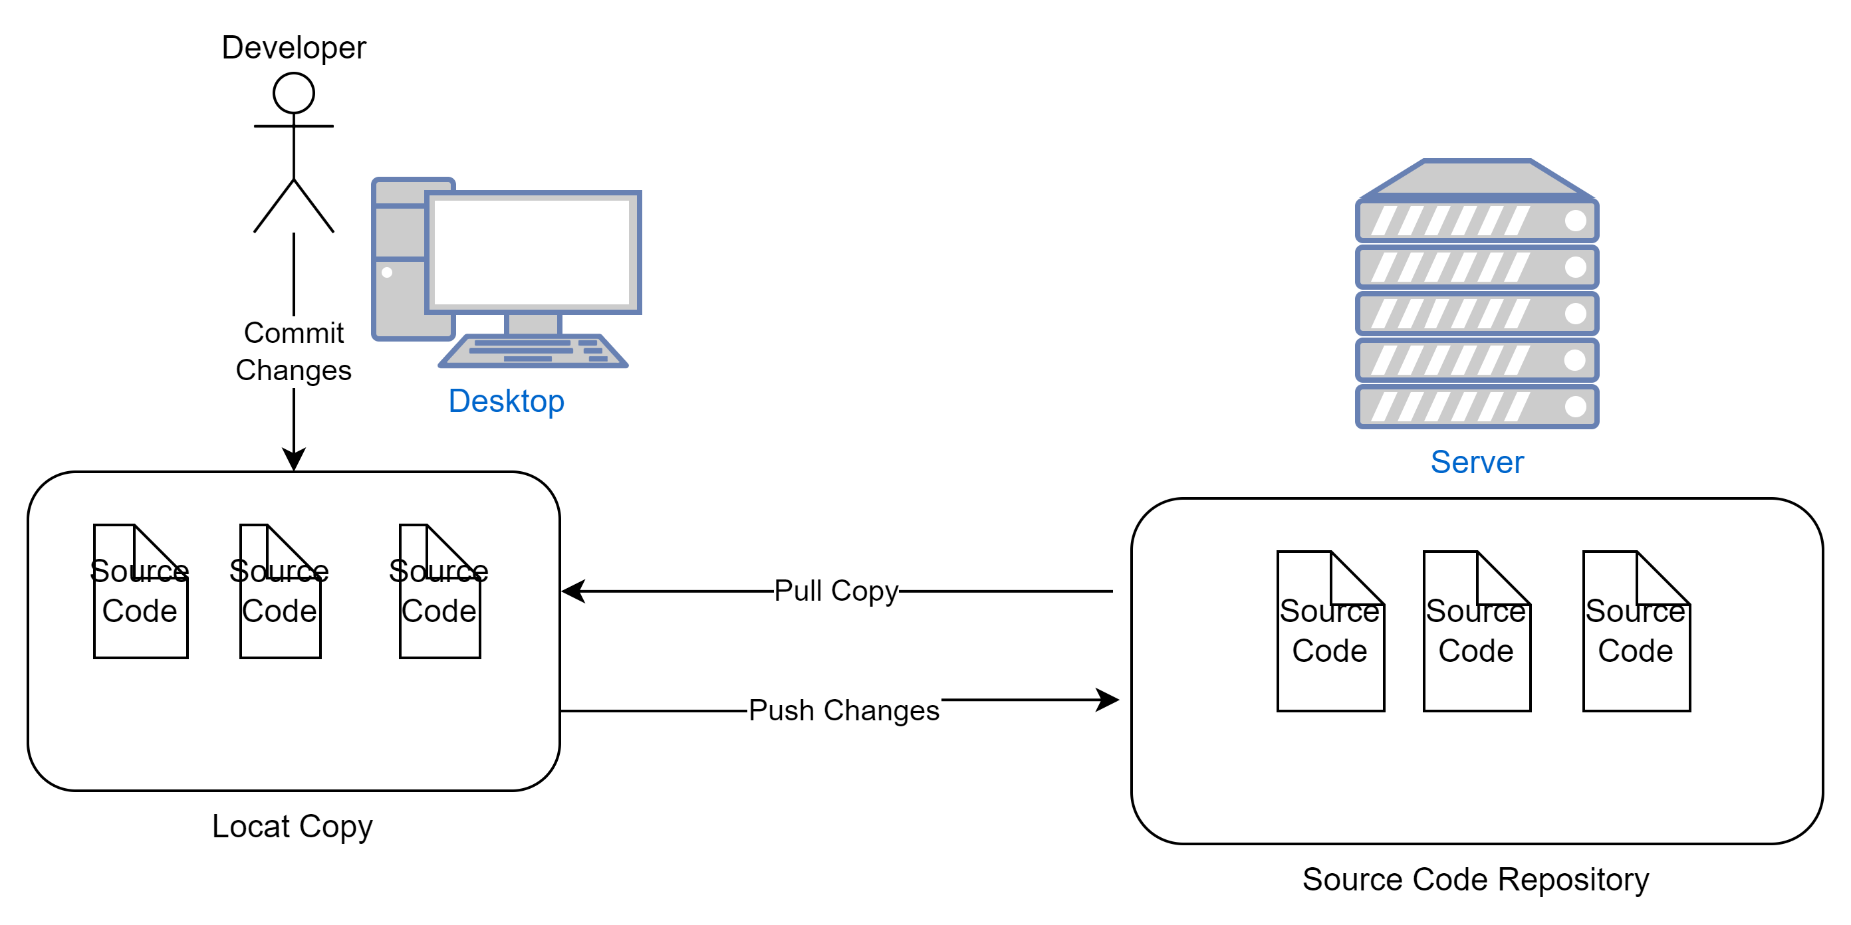
Source Control

Slide 6

Source Control – Making a Local Copy
When a new developer starts on the project they can "pull" all the files from the repository in order to build the application.
The developer can then start making changes to the code, either adding new files or updating existing files.

Slide 7
Source Control – Committing Changes
When a developer has completed their own changes (and tested them) they can add or "commit" their changes.
The committed change can then be added (or "pushed") back into the code repository.

Slide 8

Branching
This process is fine for very small projects, but the problem is that the developer can add the code to the 'main' code base with any control.
Instead, we make a controlled copy of the code called a "branch".
In the branch we can make and commit changes without changing the main code.
When we are happy that the code is fully reviewed and tested, we can "merge" the changes back into the main branch.

Slide 9
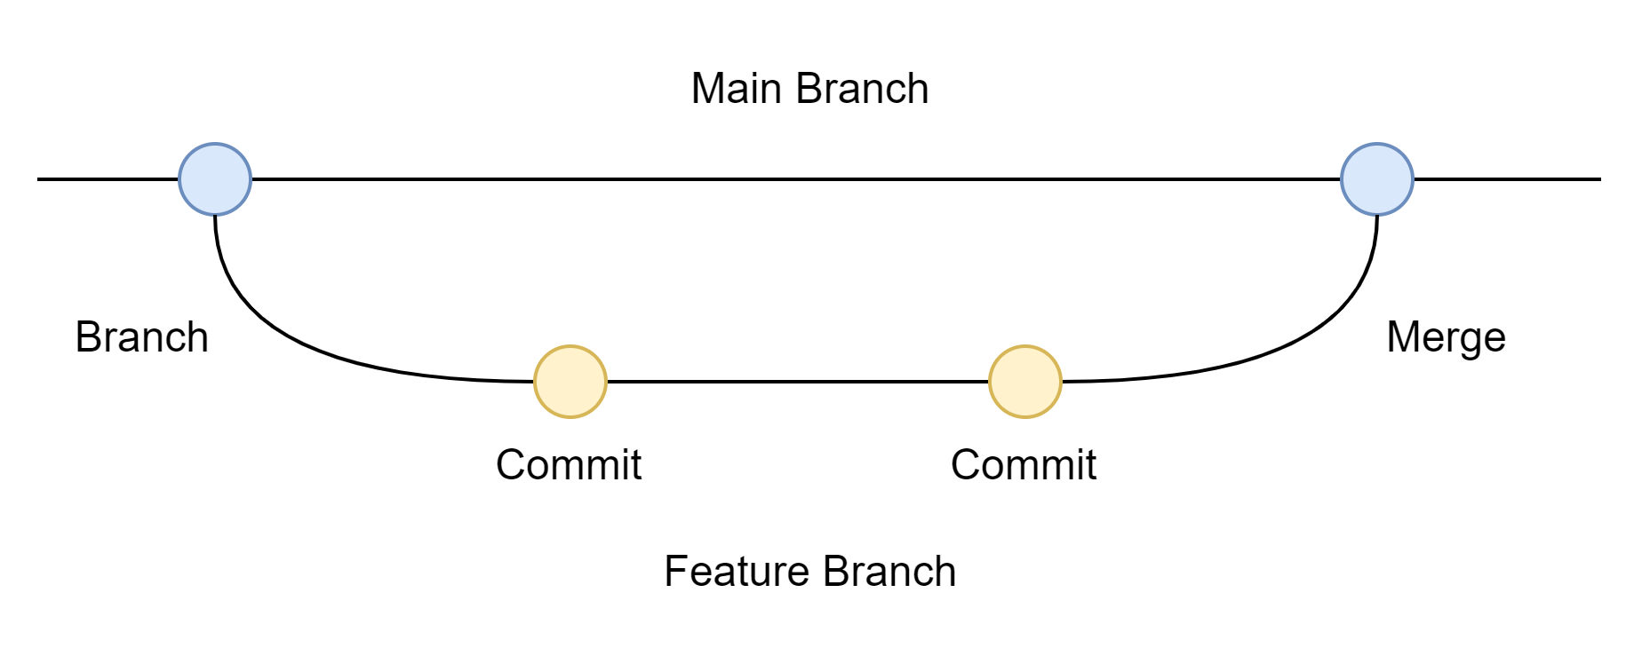
Branching and Merging
Suppose we have a feature request to develop.
We first create a branch to make our changes
We make changes and commit the changes to our feature branch,
When the code is ready it can be merged back into the Main Branch

Slide 10
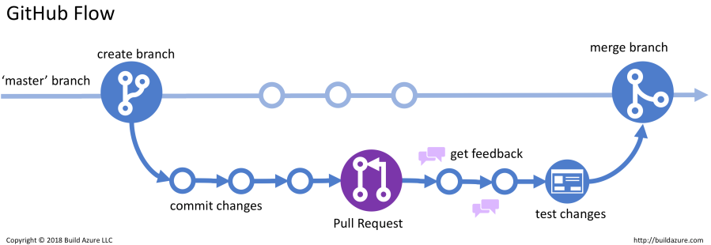
Code Review
Most repositories also have a mechanism for reviewing code before it is merged back into the main branch.
This is often called a "Pull Request".
This sends a message to the team inviting feedback on the proposed changed.
If everyone is happy and/or suggested changes are made, the branch can be merged back into the main branch.

Slide 11
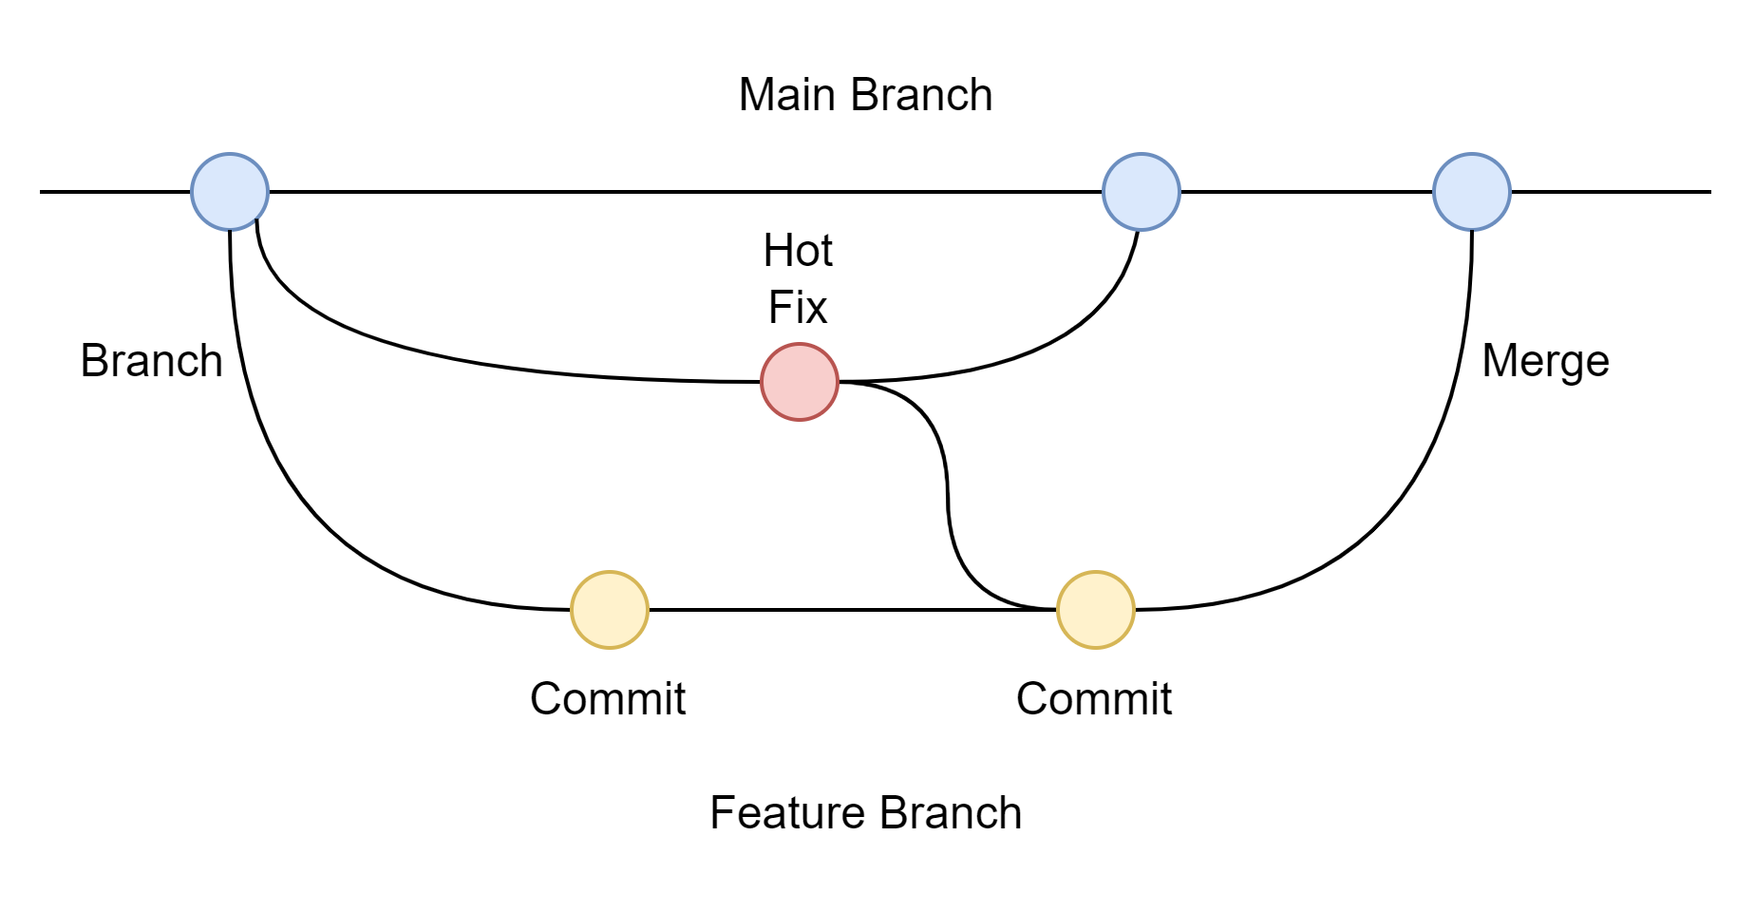
Changes and Fixes
Sometimes a bug is discovered that needs changing very quickly.
In this case we may do a 'hot fix' branch to make rapid changes and add them to the main branch.
It is important that the fix is also included in the feature branch, so the fix can be tested with the new feature code, before merging.

Slide 12
Branching Strategies
So far we have seen a very simple branch strategy – code is branched from the main branched and merged back in.
We often use more complex branching, for instances to create a branch every time we start developing a new release.
Branches can also be used to represent staging.
In larger systems, there may be multiple projects in flight at the same time, all on different release schedules.
Branching can get very complex.

Slide 13
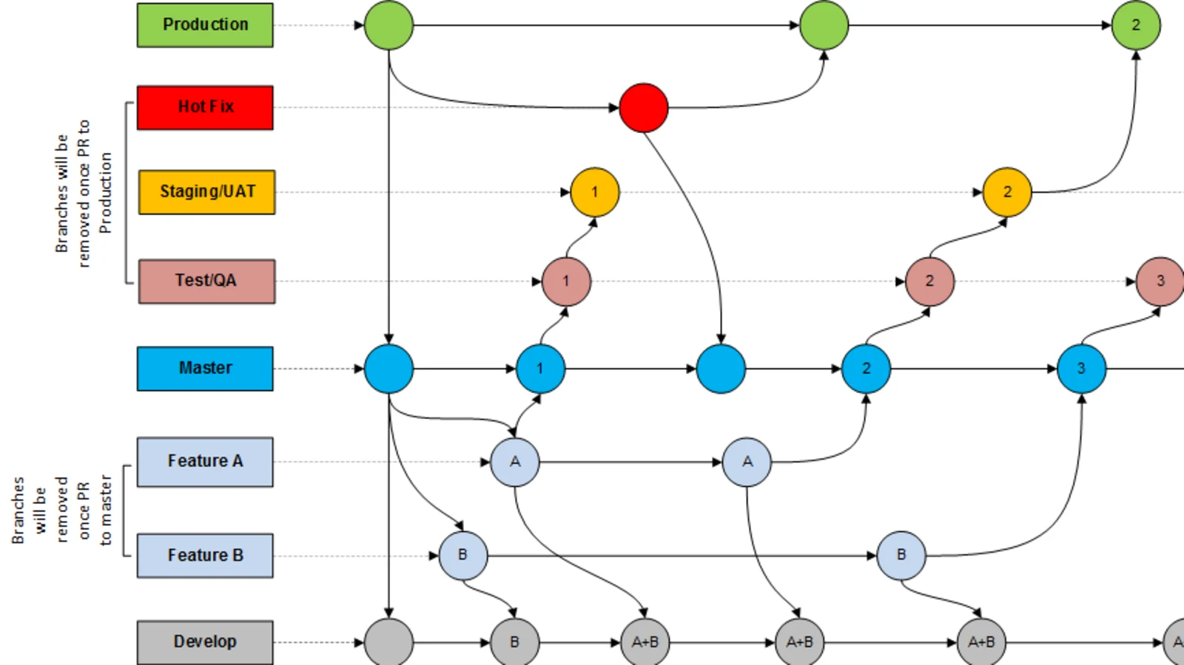
Branching Strategies
Example of complex branching for staging

Slide 14
Challenges of Long Running Branches
As can be seen from the previous slide, long running branches can become very complicated. This has a number of problems:
  It can become confusing for developers to track the correct branchera
  It can become difficult to know which branches to merge
  Faster changes and hot fixes need to be merged multiple times
  Overall, far more easy for errors to occur.

Slide 15
Continuous Integration Strategy
An alternative approach, which is becoming increasingly popular, is to follow a strategy of Continuous Integration.
In this approach the 'main' branch is updated with changes as soon as they are completed and tested.
The steps a developer follows for each change or 'feature request' is:
  Create a branch from 'main' for the 'feature'
  Develop the changes just for the feature
  Test all changes – this means testing the new change, and ensuring nothing has been broken in the existing code (called regression testing).
  Approve and apply the change back to the main branch.
  Remove the feature branch.

Slide 16
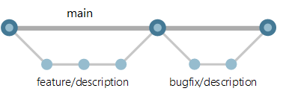
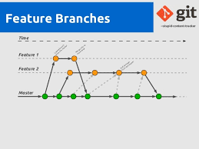
CI Strategies
In simple projects we can take a branch from main and then merge before the next branch.
More commonly, multiple feature branches happen concurrently, and the developer will need to merge main branch in the feature branch one or more times before merging.

Slide 17
Continuous Integration
Continuous Integration has the following advantages:
  Developers are always working on the most recent code (almost)
  There are only a few branches at any one time (usually no more than the number of developers on the project)
  There are no consistency problems between branches
  Small changes and fixes do not need to be merged to longer running projects.
  Reliability of an application has shown to be better if small regular changes are made, rather then infrequent larger changes.

Slide 18
Continuous Integration Challenges
The challenge of Continuous Integration (and why it was not done in the past) is:
  Changes need to be re-integrated into the main branch very regularly (normally a feature branch won't last long than a day or two).
  Any change can break or destabilize the current production code.
  Larger releases can be made up of many features which need to be released together.

Slide 19
Continuous Integration - Solution
To be able to make changes on the main branch reliably the whole system must be retested, along with the new feature every time the code is merged.
To do we need to Automate all or most of our testing. This requires advanced tooling and processes – which will be the focus of next semester's operations module - Automated Testing and Continuous Integration'
There are also approaches to managing changes for larger releases such as 'feature switches' which will look at later.

Slide 20
Recommended Reading
The Git web page has an excellent online book at:
  https://git-scm.com/book/en/v2
If you read the first three chapters of this book you will have a very good understanding of source control with Git.

